Slide 1
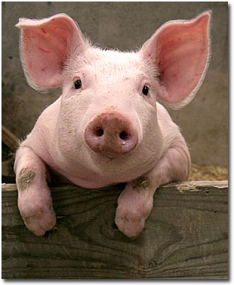
2025 Showmanship Clinic Hyde County Cooperative Extension
Hogs

Slide 2
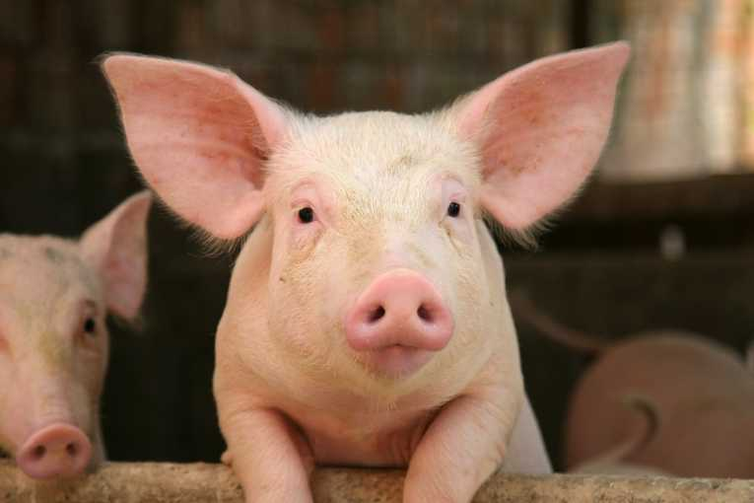
Rules for Good Health
Provide proper housing
Practice good sanitation
Provide good nutrition
Provide clean water
Observe your animal for strange behavior

Slide 3
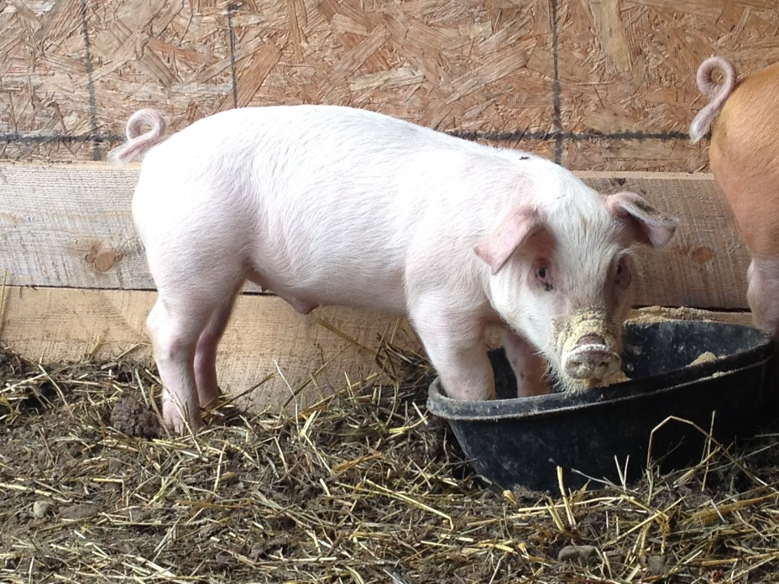
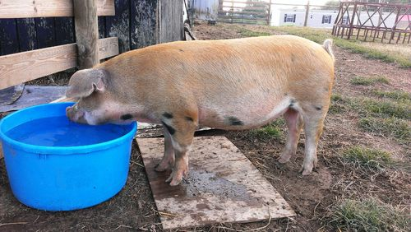
Nutrition
Fresh, clean water at all times
Feed that is at least 16% protein

Slide 4
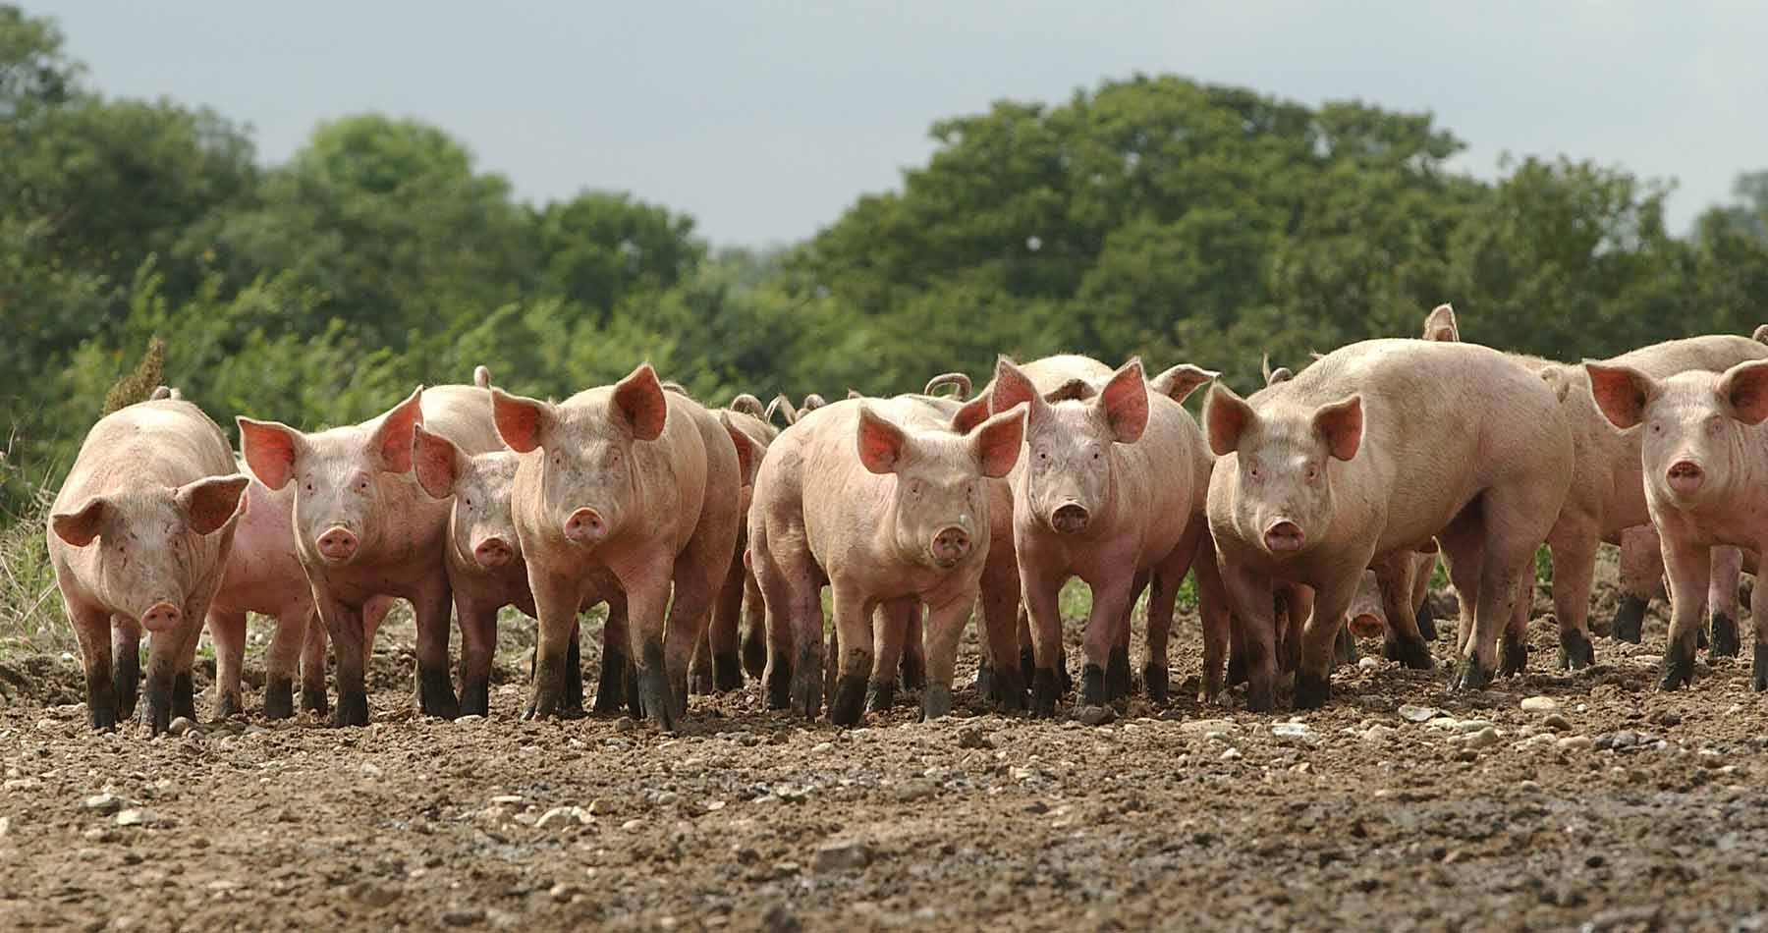
Hogs
Make sure pen is clean and dry!

Slide 5
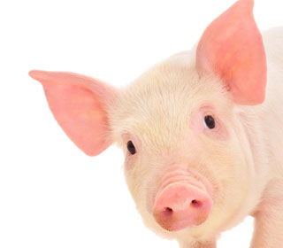
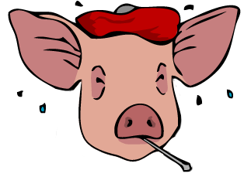
A Healthy Pig
A Sick Pig
Eats their feed
Has strong legs and feet
Has bright, clear eyes
Doesn’t eat
Runny nose
Diarrhea
Runny eyes
Limping

Slide 6
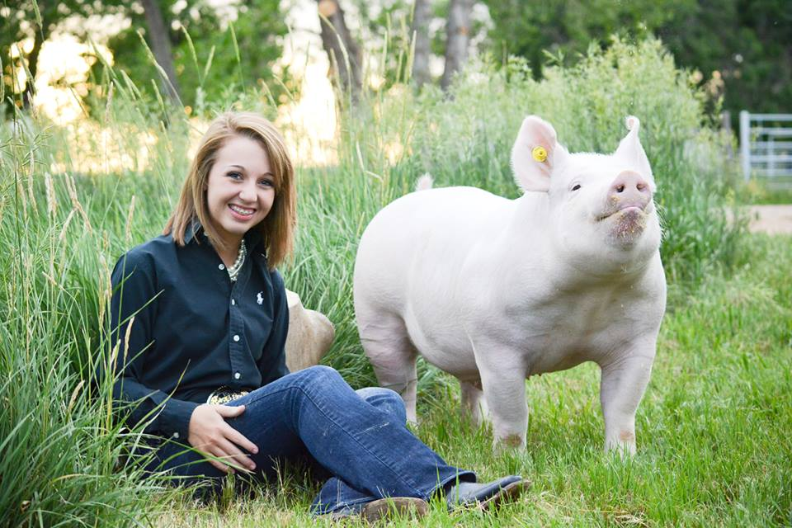
Show Preparation
Spend time with your hog as much as possible
Be calm and patient with your hog
Be sure to have a driving tool (cane, whip, etc.), small hand brush, and a spray bottle
Make sure your hog is clean (No water in the ears)

Slide 7
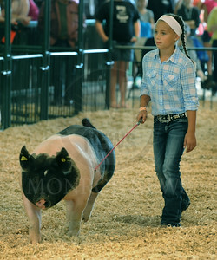
Appropriate Dress
Dress neatly and appropriately
Nice clean boots or shoes that protect your feet (no athletic shoes)
Clean button-front shirts or blouse (shirts should be tucked inside of pants)
Clean dress pants or jeans with a belt
No hats or caps should be worn
Hair should be combed/brushed neatly (braids, clips, ribbons, etc.)

Slide 8
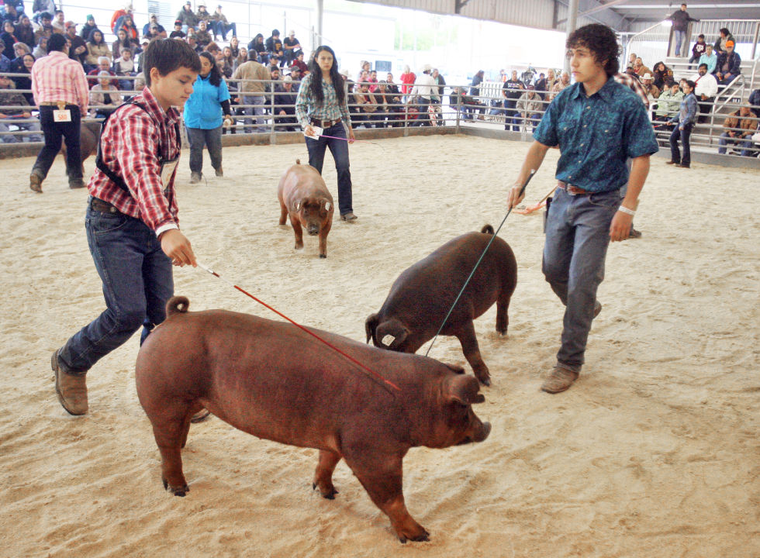
Showmanship in the Ring
Keep your eyes on the judge at all times
Do not overuse your driving tools. Use only to keep hog moving from one point to another in front of the judge
Always keep your hog between you and the judge
Drive your hog in a figure eight pattern in front of the judge.

Slide 9
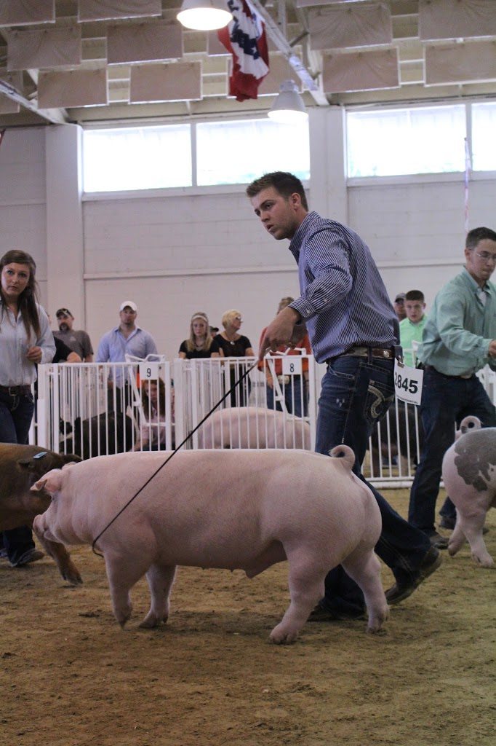
Maneuvering Around the Ring
Be courteous to other showmen at all times (do not block anyone’s view)
Do not use your hands or knees to drive the animal
Touch the right jowl to move the animal left, the left jowl to move the animal right, and the rear hocks to move it forward
Avoid danger zones and high traffic areas (corners and groups of hogs)

Slide 10
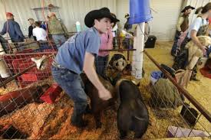
If Selected to be Penned
Raise you hand and work your hog toward the pen area
Always close and latch the gate behind you
Position your hog with its ham toward the show ring
Keep your eyes on the judge at all times and do not let your hog lie down (spray and brush hog)
Be ready to answer any questions about your hog or project
Click on available links for more tips…(you may need to right click, select “Hyperlink”, then select “Open Hyperlink.)
Showmanship Tips Video
Showmanship Scoring Guide

Slide 11
^{34th} Annual Hyde County Livestock Show
April 23rd, 2025
Have fun, work hard, and good luck!!!

